Slide 1
Magic Of Micro-Controller
An Intensive Training Course on Micro-Controller
Brought To You By TechShopBD.Com

Slide 2
Topics
Liquid Crystal Display (LCD) Interfacing
What is LCD ?
Structure of LCD
Types of LCD
Pinout of 16x2 Dot-Matrix-LCD
Mode Of Operation of LCDs
LCD interfacing with MCU

Slide 3
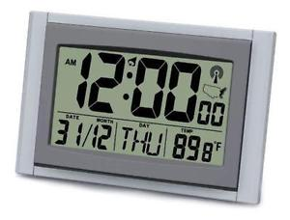
LCD
LCDs are used to display numbers, characters, symbols and graphics.
They are used in many embedded systems such as, digital clocks, watches, microwave ovens, CD players etc.

Slide 4
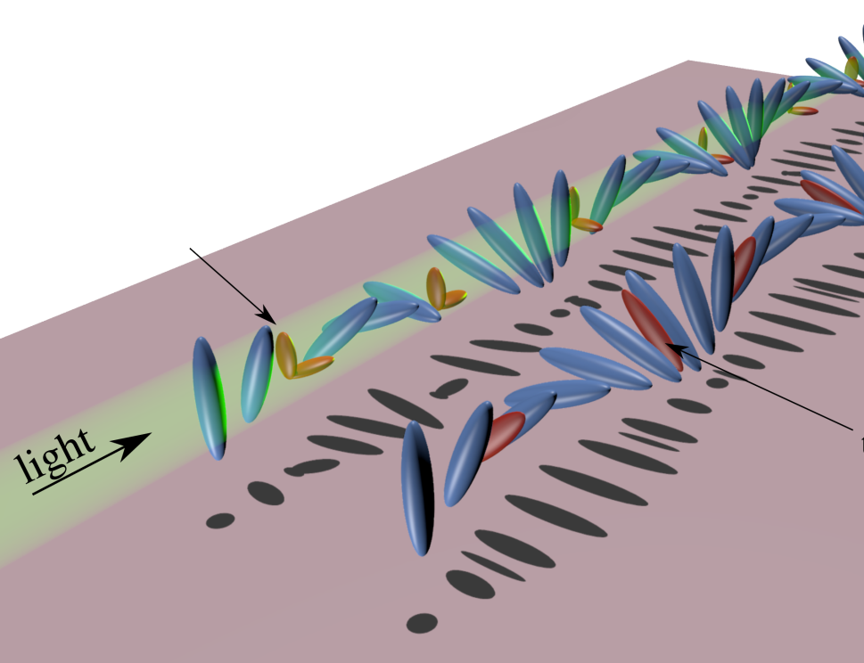
How LCDs Work ?
A liquid-crystal display (LCD) is a flat-panel display or other electronically modulated optical device that uses the light-modulating properties of liquid crystals.

Slide 5
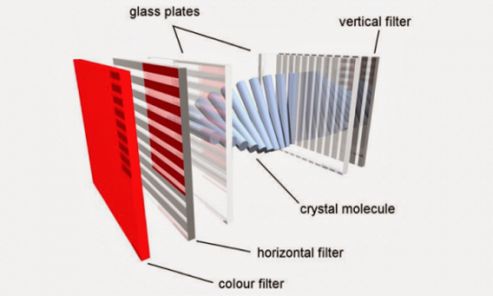
Structure of LCD

Slide 6
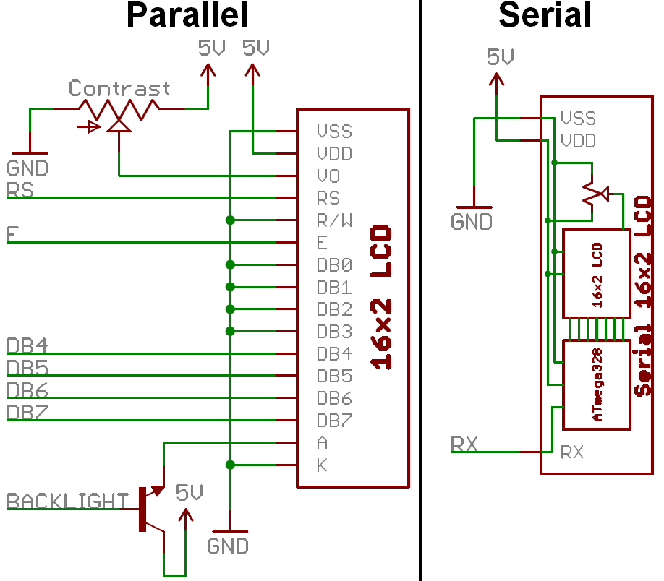
Types Of LCD
Parallel LCDs
Serial LCDs

Slide 7
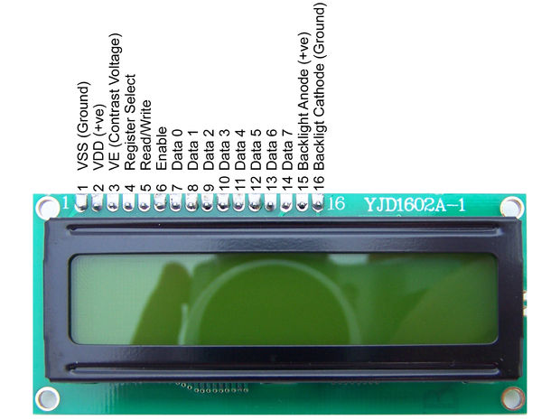
Pinout Of 16x2 Dot-Matrix-LCD

Slide 8
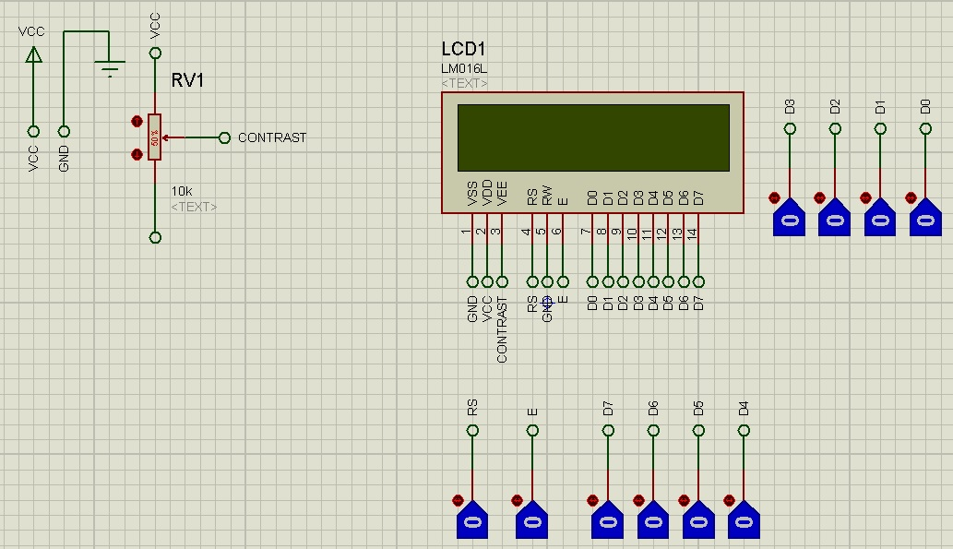
Mode Of Operation of LCDs
8-bit Data Mode
4-bit Data Mode [Most Commonly Used]

Slide 9


Slide 10


Slide 11
Thank You

